Slide 1
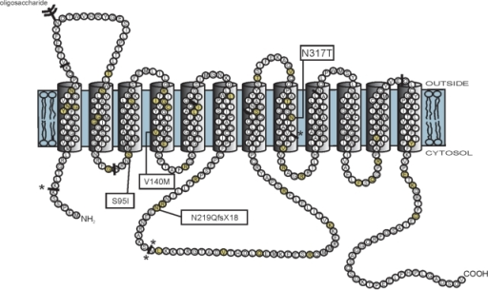
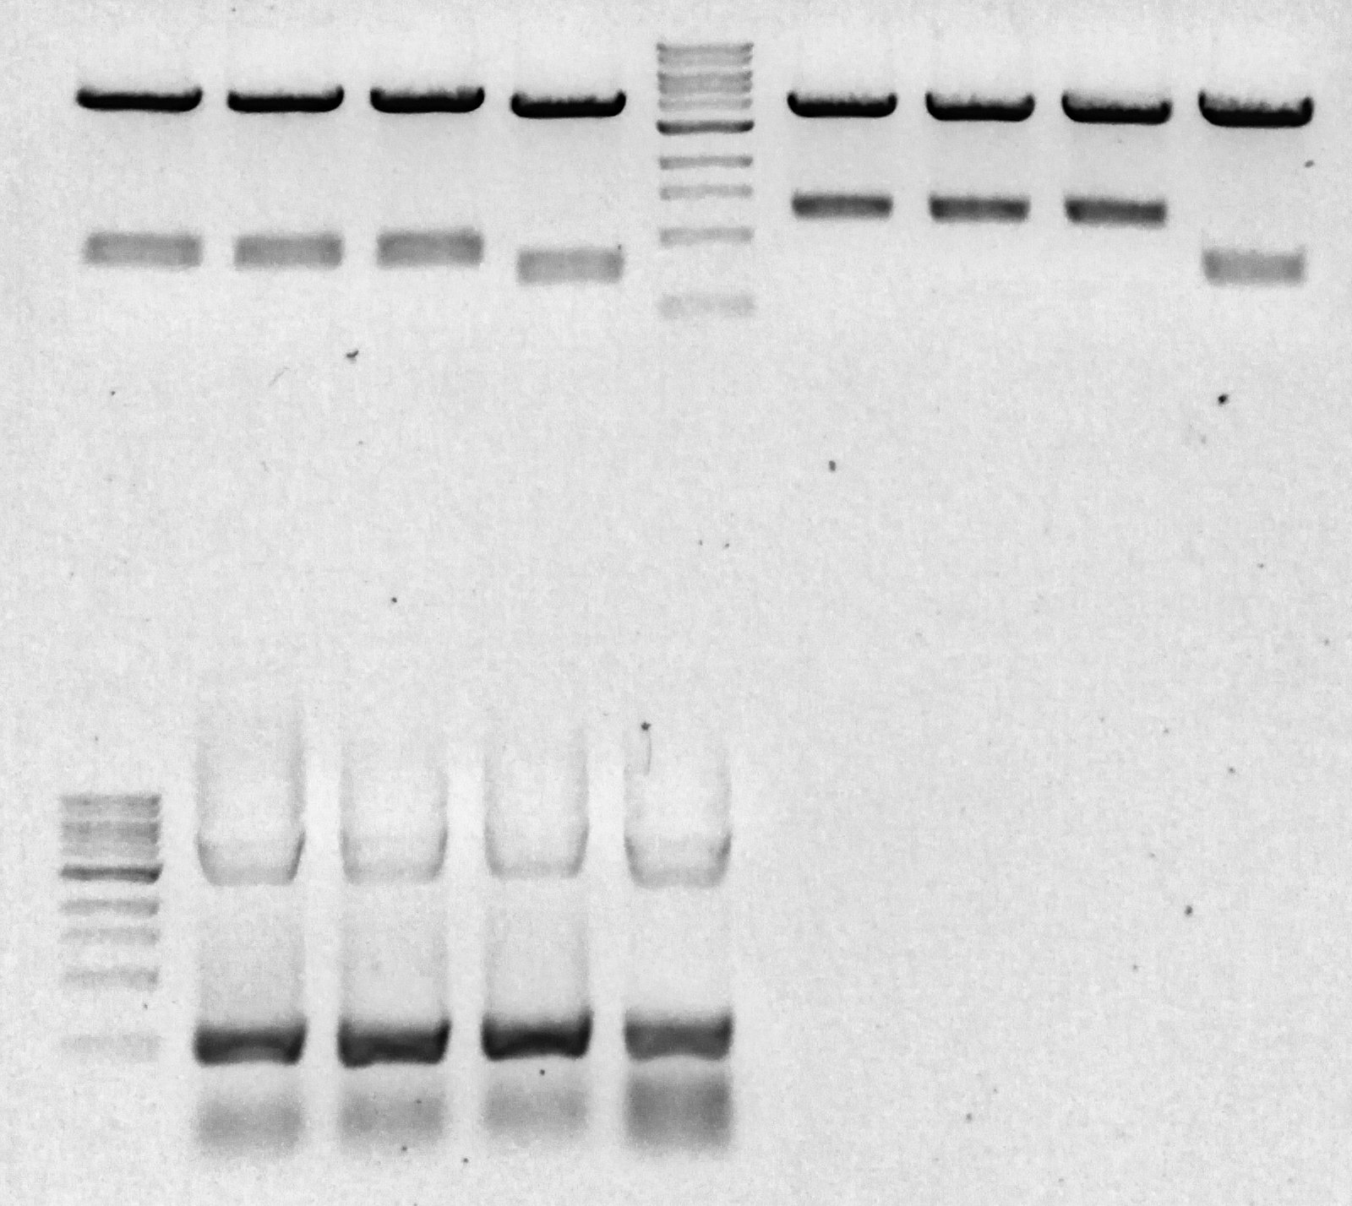
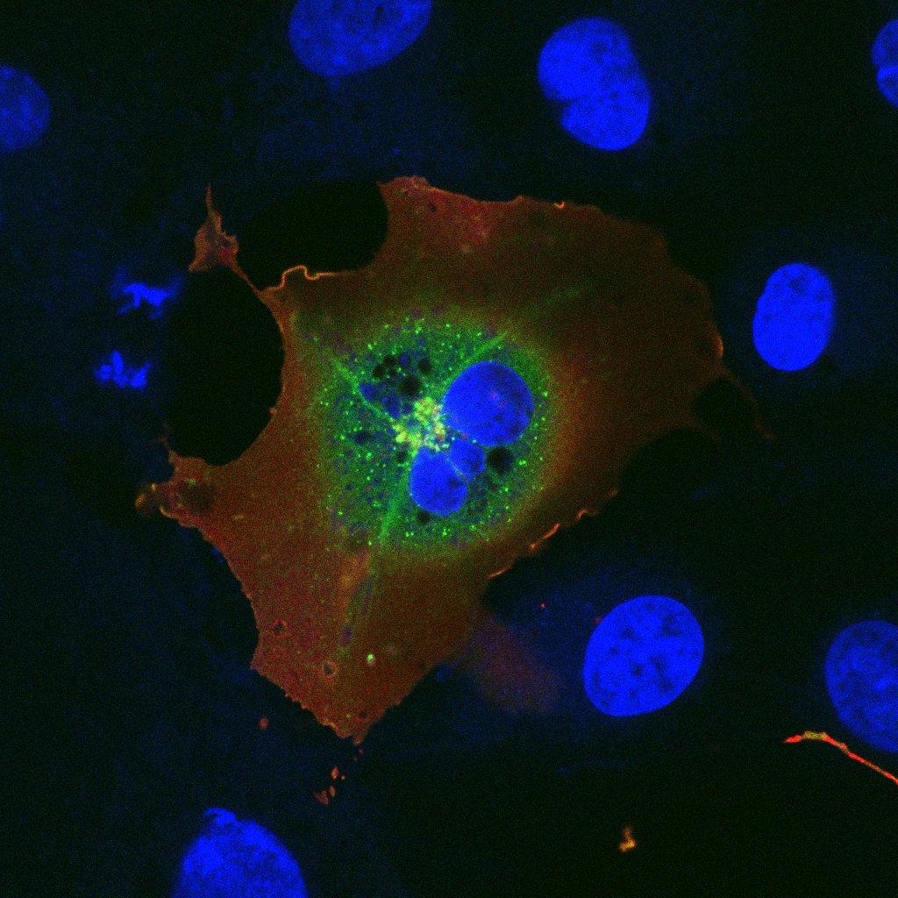
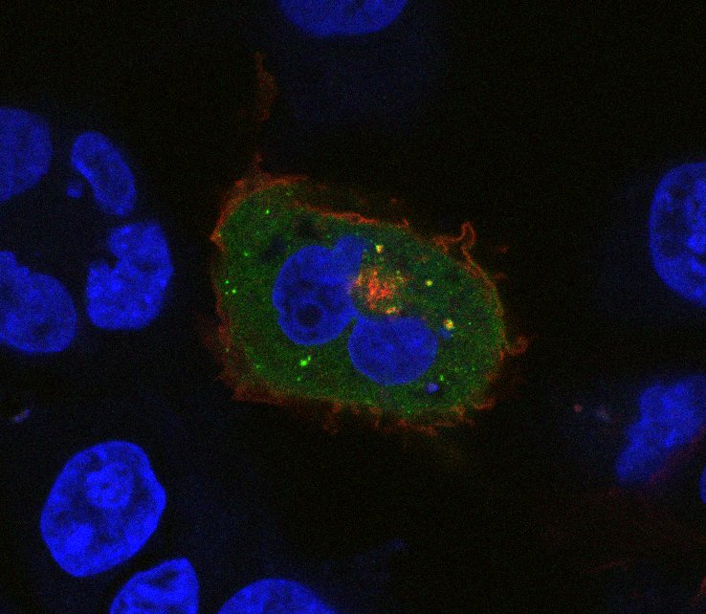
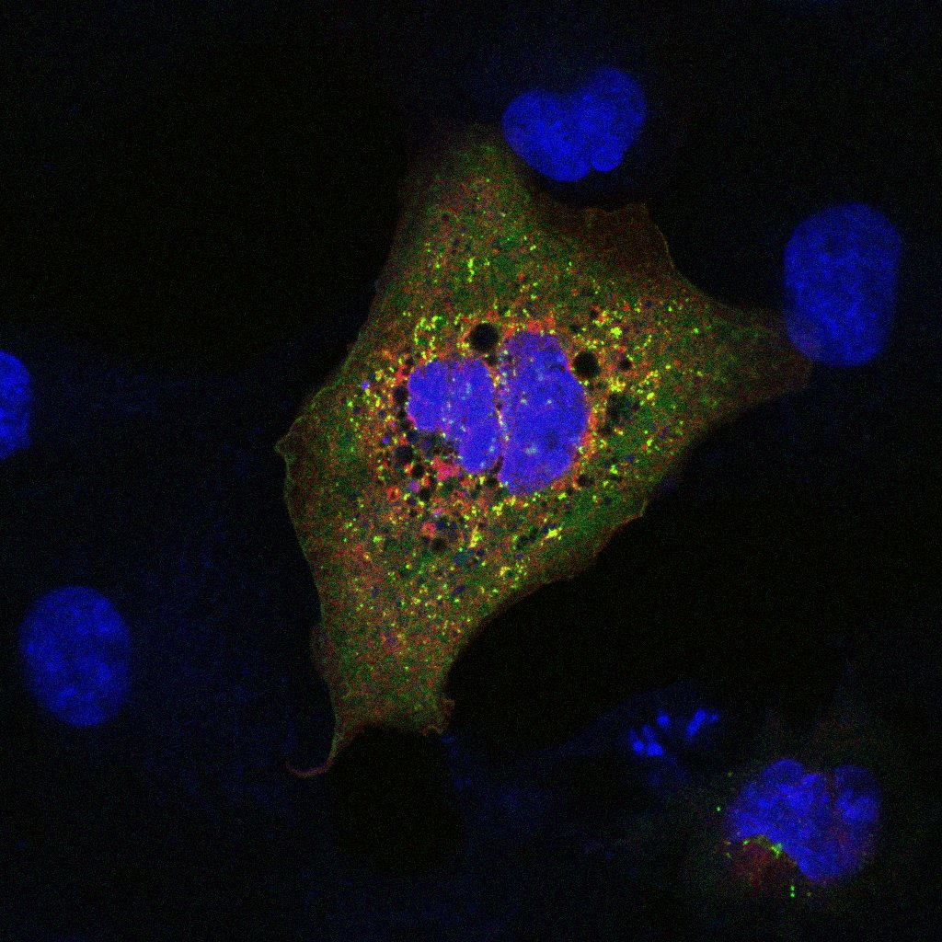
Searching For GLUT-1 Transport Protein Interactions
Sarah Catlin and Kyle Timmer, Professor Eric Arnoys. Calvin University, Grand Rapids, Michigan
Introduction
Methods
The protein GLUT1 allows glucose into cells through the cell membrane. GLUT1 is made inside of the cell; however, to be able to transport glucose, GLUT1 must move to the membrane. We are interested in finding which proteins are responsible for GLUT1’s transport.
In a previous study, the endoplasmic reticulum (ER) proteins sec23 and sec24 were found to have the potential to bind to GLUT1. These proteins help facilitate vesicle formation for transport. Another study found that an envelope protein of HTLV-2 can bind to surface GLUT1. This protein can be used to measure surface GLUT1, a much easier and quicker task than normal expression measurement.
Creating Fusions
Sec23 and Sec24 DNA
Primer sequences designed and ordered
sec23 and sec24 DNA isolated with primers by Polymerase Chain Reaction (PCR) on HK2 cell DNA
  HTLV-2 env
  GFP vector and env DNA (from Gene Block) fused via Gibson Cloning Technique
  Cloning success checked with Restriction Digest, PCR
  Fusion transfected to test for expression
Figure 1: GLUT1 Structure (Adapted from Suls et. Al (2008). Brain 131. 1831-44.
Conclusions
Findings
Preliminary confocal imaging confirmed co-localization to be present
env-GFP fusion successfully created
Future Direction
Larger confocal imaging sample size is now needed to provide strong evidence for GLUT1 and sec protein interaction
env-GFP fusion can be transfected into cells, expressed, and used to measure surface level GLUT1 via flow cytometry, allowing for significantly easier GLUT1 measurement
Figure 2: Gene Map of a Fluorescent Fusion (GFP_sec23b) via SnapGene
Objectives
“Cutting and Pasting”
  Vector and sec23/sec24 DNA cut at specific, identical sites by restriction digest
  Cut ends reattached via ligation
Figure 3: Restriction Digest and PCR Confirmation of env_GFP
Clone fluorescent fusions of a green fluorescent protein (GFP) vector and different versions of the ER proteins sec23 and sec24
Co-transfect the above fusions with mCherry_GLUT1 fusions and search for signs of interaction (co-localization)
Clone fluorescent fusions of GFP and the GLUT1-binding envelope protein of HTLV-2
Recreate a procedure given in literature using the env-GFP fusion to determine surface expression of GLUT1 in transfected cells
  Transfection & Imaging
  Florescent fusions of GFP_[sec23 or 24] and mCherry_GLUT2 inserted into cos7 cells
  Cells “fixed” in place and stained with Hochest to make nuclei fluoresce
  Viewed cells using confocal microscope at Hope College
References
Al-Saleem J, Dirksen WP, Martinez MP, Shkriabai N, Kvaratskhelia M, Ratner L, et al. (2019) HTLV-1 Tax-1 interacts with SNX27 to regulate cellular localization of the HTLV-1 receptor molecule, GLUT1. PLoS ONE 14(3): e0214059. https://doi.org/10.1371/journal.pone.0214059
Acknowledgements
Thanks to Professors Westrate, Looyenga and Baker for their guidance, Hope College for the use of their facilities, the Calvin Research Fellowship program for student funding, and the Calvin Biochemistry Department for the facilities, programming, and ice cream!
Figures 4 and 5: mCherryGLUT1 GFP_sec24a co-transfection
Figure 6: mCherryGLUT1 GFP_sec24b co-transfection
10848-1 calvingraphics@gmail.com

